Slide 1
Putting Data Classification at the Foundation of Data Protection
The First Choice for the Secure Organisation
<name> <title>

Slide 2
About Boldon James
Global leader in data classification and secure messaging solutions
Established in 1985, headquartered in the UK with 60+ employees
Owned by QinetiQ Plc -$2bn defence & security technology business
30 years experience in delivering complex secure messaging, data security and information management solutions
Global presence, local expertise – with offices in the UK, US, Australia and Europe. World wide coverage through channel partner network.
Notes:
“Global leader in data classification and secure messaging solutions, helping organisations of all sizes manage sensitive information securely and in compliance with legislation and standards, in some of the most demanding operational environments in the world”

Slide 3
QinetiQ Divisions & Products
Air
Maritime
Training
C4ISR
Cyveillance®
EMEA Services
Weapons
Australia
Procurement
Advisory Services
Cyber Security
Space
OptaSense®
Unmanned Systems
Global Products
IP & New Technologies
Survivability
Boldon James

Slide 4
Microsoft Relationship
“This highest level of Partner status, combined with their long standing relationships, provides Boldon James a unique level of access to new Microsoft products, development support, and commercial support.”
“This level of access is not available to other independent software vendors in the messaging sector.”
Notes:
In support of a recent number of bids we ehave been asked to provide ‘evidence’ of this releationship. This is an exstract of a letter/refenece form Wayne Phillips (Director, Micorsooft Defence nad National Security – Microsoft. There are a couple of sections within this note that I believe powerfully demonstrate the Boldon James/Micorosfot relationship.

Slide 5
Client experience
Over 5 million end users of our technology globally
Customers across multiple sectors, Financial Services, Law, Oil & Gas, Pharma, Manufacturing, Telcos, Military, Intelligence, Government
Global organisations trust us to protect their sensitive data….

Slide 6
Why is Data Classification Important Today?

Slide 7
Security problems have evolved
Peer to Peer or Group
Organisation to Organisation
Collaborative Apps and Social Media
Unstructured data
Distributed information
Virtual Infrastructure, BYOD and Cloud
People are the new perimeter!
Transactional Apps
Structured Data
Centralised information
On-premise infrastructure
Perimeter-based security
Notes:
IT Must Evolve to Meet New Demands
We see a significant change in the role of IT in enterprises from system-centric to information-centric.
To date, IT has brought significant productivity benefits to organizations by automating key business processes and driving efficiencies. This landscape was characterized by various business applications working centralized databases, supported by physical infrastructure. A lot of what IT departments did was focused on managing systems, including PCs, servers, storage, and networks.
Today, the role of IT is starting look very different. Organizations are looking for the next level of productivity and business agility by improving collaboration and knowledge sharing. They are looking to better connect their employees, teams, business partners and customers to each other. This is changing the nature of data into highly distributed, largely unstructured information. The infrastructure is moving virtual within the company or turning into an external cloud. Instead of focusing of physical systems management, the role of IT is transforming into more information-centric tasks with governance, policies, risks, and controls.
This evolution is also apparent in how applications are being designed. Historically, the entire ‘stack’ from database, OS, server, storage were defined per application. Today applications are being written to run on virtually any platform and by design will be agile to move from one system to another based on events (performance, availability, workload, etc).

Slide 8
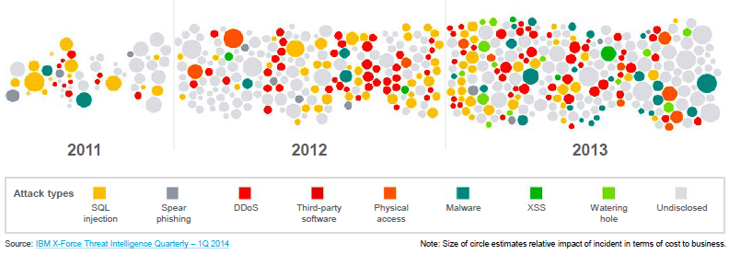
Era of continuous breaches
Operational
Sophistication
Year of the breach
Daily leaks of
sensitive data
40% increase in
reported breaches
Relentless attacks & breaches
500,000,000+ records leaked
Notes:
We are in an era of continuous breaches
Attackers are relentless, victims are targeted, and the damage toll is rising
(IBM Quarterly Threat Intelligence Report Q1 2014)

Slide 9
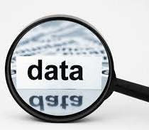
The Data Challenge
“worldwide information volumes are growing at in excess of 60%”
“800% growth in unstructured data in next 5 years” (Gartner)
“the substantial growth of data is fast becoming unmanageable”
What data are we talking about?
What are the risks?
How do you know?

Slide 10
Data Privacy Issues
Data Laws becoming more stringent Disparity in data privacy regulations globally
Data Privacy for certain types of data is mandated by law
Data must be understood and classified in order to be adequately managed, controlled, and protected
Once critical data and systems have been identified, controls must be implemented to achieve the privacy that is required
Notes:
Stringent = e.g. EU Data Protection
Disparity – this was mentioned on the last SIG webcast – they referred to McAfee who devotes a page to all the various data privacy/protection regulations that they operate globally – there is a lack of a uniform approach globally

Slide 11
The crux of the problem…
…because we’ve all pressed this by mistake!!

Slide 12
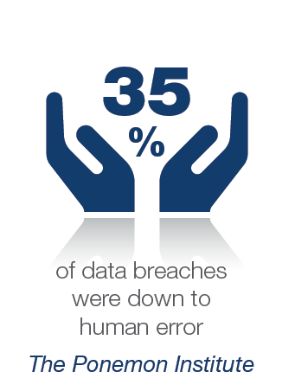
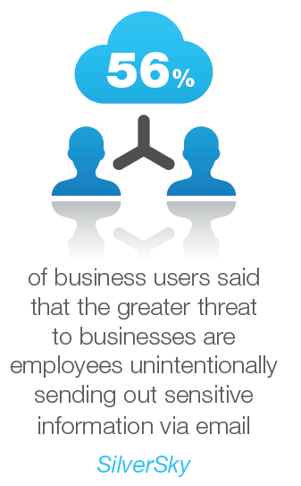
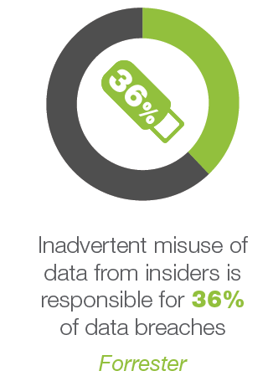
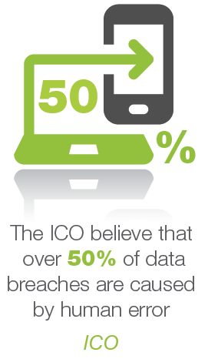
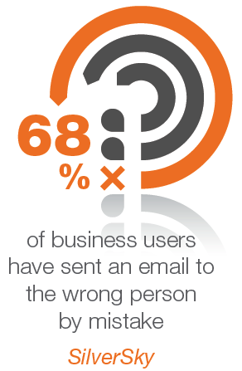
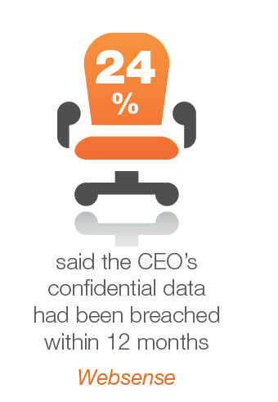
Hard truths around data loss

Slide 13
The Price of Unmanaged Data
Data Protection Act
EU Data Protection Laws changing
ICO Fines
MoJ
Fined £140k
(2013)
Sony
Fined $416k
(2013)
Zurich Fined €3.1m (2008)
What is the value of a reputation?
Notes:
New EU Laws = Up to 5% of Global Turnover (up to a cap of £100m)

Slide 14
Cost & Impact of data breach
Average cost of a data breach increased in 2013 by
15%
A single lost or stolen data record cost on average
$145
Average cost of a single sensitive data breach in 2013
(Ponemon Institute)
$3.5m
The cost of data breach is on the rise and affecting customer retention
Notes:
Ponemon Institute – Cost of Data Breaches Report 2013
Significant financial risks for organisations to consider – not to mention the reputational damage / cost

Slide 15
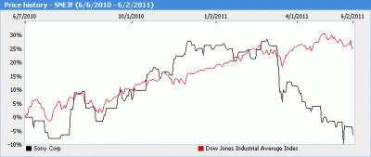
Data breach impact on share price
$272m hit on operating profit
9% drop in share price
$1.25bn lost revenue (est)
Notes:
27th April:
Sony suffered a massive breach in its video game online network that led to the theft of names, addresses and possibly credit card data belonging to 77 million user accounts in what is one of the largest-ever Internet security break-ins.
Sony learned that user information had been stolen from its PlayStation Network seven days ago, prompting it to shut down the network immediately. But Sony did not tell the public until Tuesday.
"Sony has estimated the data breach will result in a $170m (£104m) hit to its operating profit. Pundits say the cost of reputational damage is likely to be much greater," wrote Computer Weekly's Warwick Ashford.

Slide 16
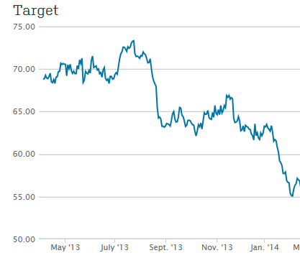
More recently….
11% drop in share price after data breach revealed on 19th Dec 2013
Notes:
Target’s data breach over the holidays — in which data from 40 million credit and debit cards and the personal information of 70 million customers were stolen — will likely prompt “material labor and infrastructure costs” as the company upgrades its systems, says Faye Landes, an analyst at Cowen & Co.
Between replacement cards and terminals, legal and settlement fees and other breach-related issues, Ms. Landes says Target will have numerous costs on its plate in the coming months.
THE BREACH EFFECT
Target said of the $61 million in expenses related to the breach during the quarter, $44 million were offset by an insurance payment, bringing the impact to $17 million.
Mark Rasch, a former cyber crimes prosecutor who worked on some of the biggest U.S. payment card breach cases, said that it was too early to estimate how big the bill would be, but it would certainly be in the hundreds of millions of dollars and could top $1 billion. "We know it is going to be big. We just don't know how big," he said.

Slide 17
Security now board-room concerns
CEO
Loss of market share and reputation
Legal exposure
CFO/COO
Fines
Criminal charges
Regulatory failures
Financial loss
CIO
Loss of data integrity
Data protection failures
CRO
Financial risk
Business & legal risk
Audit failures
CMO
Brand reputation damage
Loss of brand trust
CISO’s are now being appointed to board room positions
Notes:
Summary = information security now being address at board-room level as a result of the increasing volume and value of data to the organisation and the risk of loss/breach

Slide 18
Protecting sensitive data

Slide 19
Keeping CISO’s up at night
Not knowing where sensitive data is
Only 7% know where
Unstructured data resides
57%
7%
79%
said that not knowing where the organisations sensitive data is represents a significant security risk
Source: Ponemon Report: The State of Data Centric Security (June 2014)
Notes:
Today, many organisations are not aware of what their Critical or most sensitive data is, where it resides, who has access to it, or how it is protected.
Possessing information about Critical sensitive data is necessary in order to determine whether adequate controls are in place.
Sensitive data protection is dependent upon having access to vital information in order to apply proper controls.

Slide 20
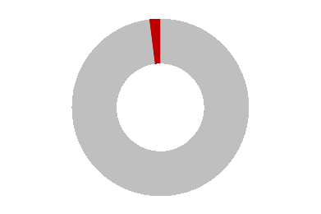
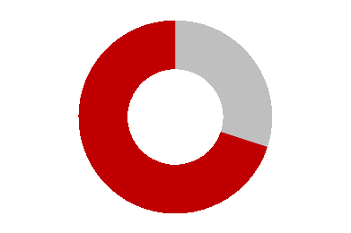
Identifying sensitive or critical data
An average organisation’s
critical data is less than…
Business value that is estimated to be contained in critical data…
2%
70%
Examples of Sensitive Data:
Mergers & acquisition plans
Business plans
R&D plans
Company results
Drug formulas
Manufacturing drawings
Employee data
Customer data
Payment information (PCI)
Fiscal trading data
Source: U.S. President’s 2006 Economic Report to Congress
Notes:
Although on average less than 2% of a organisations data is deemed as being “Critical”, it can represent over 70% of an organisations value
Some examples of the type of sensitive data – essentially any data that contains valuable intellectual property

Slide 21
Critical data is high value
Value
Business
Critical
Critical IP
(e.g. design files)
Top secret plans & formulas
C-Level
Merger & Acquisition plans
Investment decisions
Regulated
PCI-DSS
PII
DPA
HIPAA
GSC
ITAR
SOX
Business
Strategic
Business
plans
Strategic Partner
plans
Company
Results
Product
roadmap
Business
Unit Critical
Audit
reports
Customer
records
Commercial
pricing data
Security
data
Project
plans
Contracts
Employee /
HR data
Accounting
data
Operational
Press
releases
Market
intelligence
Official
results
Public
Partner list
Source: IBM Corporation
Notes:
Categories of data by Type and ranked according to value to the organisation – with examples of what types of data this could be in your organisation
Many organisations struggle with where to start, so starting on the most Critical data and then working down is a best practice approach – protect the most critical assets is the top priority here (and usually the easiest /quickest task to undertake)

Slide 22
5 steps to protect your sensitive data
1
Identify – your sensitive data
2
Discover – location and accessibility
3
Classify – data according to its value to the organisation
4
Secure – employ security control and protection measures
5
Monitor – measure and evolve
security practices
Notes:
Identify – sensitive and indeed non-sensitive data (remember not all data requires the same level of protection e.g. non-business). Until you know what you have got, you can’t make informed decisions on how to protect it
Discover – find out where sensitive data resides and how it is being used? (possibly using a data governance solution such as Varonis or Symantec)
Classify – data according to the value to the organisation – what would the impact be to the business if this data was lost or leaked?
Secure - assess the security and protection requirements for sensitive assets (and non-sensitive) based on level of importance and value to the organisation. Basically what measures are required to protect business critical data? Determine the functional and solution gaps and then plan and implement the technical and business changes required to protect assets whilst enabling accessibility.
Monitor – Determine metrics and processes for monitoring classification application and security performance, as well as how you will report and communicate the results. This is likely to Continue to evolve and adapt to changes that are required – process and infrastructure/solutions. Revalidate and improve security programme effectiveness.

Slide 23
Securing Data Throughout the Lifecycle
Secure Deletion
Content Discovery
Classify
Rights Assignment
Secure Deletion
Content Discovery
Classify
Rights Assignment
Delete
Create
Encryption
Rights Management
Content Discovery
Access Control
Asset Management
Encryption
Asset Management
Encryption
Encryption
Rights Management
Content Discovery
Access Control
Archive
Metadata
Store
Share
Use
Access Controls
Rights Management
Activity Monitoring
Encryption
Application Security
Data Loss Prevention
Encryption
Application Security
Data Loss Prevention
Access Controls
Rights Management
Activity Monitoring
Notes:
End-Users create the vast majority of an organisation’s unstructured data
Capturing the user’s insight at the point of creation in the form of classification metadata is first step in ensuring data is correctly protected
Metadata can be used right throughout the Information Lifecycle to drive a range of security and data management solutions and processes…

Slide 24
What is Data Classification?

Slide 25
What is Data Classification?
Visual Markings
Metadata
Involving the user to place a key identifier onto a piece of information to ensure appropriate handling
Policy
Handling Rules

Slide 26
Ways to Do Data Classification
User Driven
System Generated
Manual
Notes:
Manual : Policy guidance is circulated and training given, but users are left to manually type classifications into their emails, documents and files. By far the cheapest method, but very risky as it’s not consistent or enforceable.
System Generated: Often provided by Data Governance or Content-Aware DLP solutions, which use software algorithms to select a classification. Although more consistent and enforceable, when used alone, it can result in false positives/false negatives and lowered trust within the user community.
User Driven: Captures the user’s knowledge of the value of the data they handle, so that more informed decisions can be taken about how it is managed, protected and shared. Although it presents a minor speed-bump to the user, it leads to reduced errors, increased trust and improved system performance, lowering the overall risk of sensitive data being lost.

Slide 27
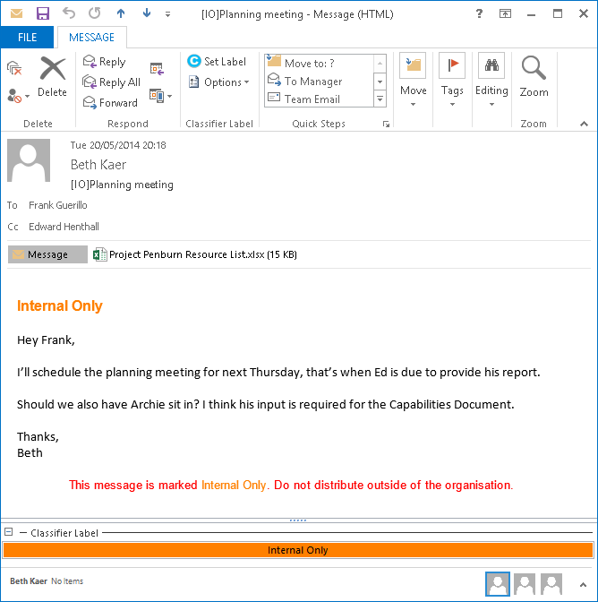
User Driven Data Classification
Dynamic and proactive labelling
Single click buttons
Enforce labelling/data classification policy
Domain, user & attachment checks
Subject line prefix
Ensure consistent markings are applied
First line of text
Fully customisable images, labels and text
Last line of text
Visual labels & metadata
Visual summary pane
Multiple platforms & file types

Slide 28
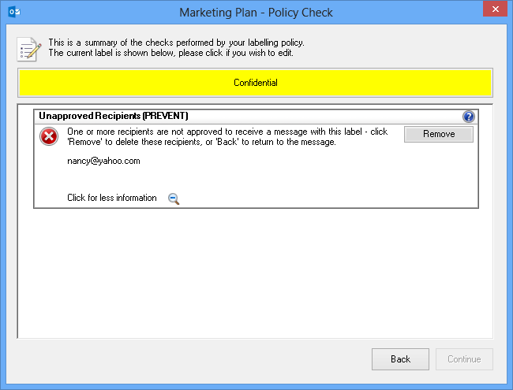
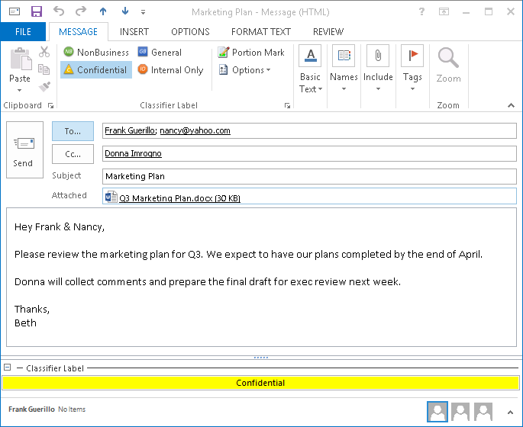
Preventing Against Accidental Loss

Slide 29
Types of info to protect
SHARING & COLLABORATION
CREATION
Notes:
Data Classification solutions extend the capabilities of Microsoft products and other applications to allow users to apply relevant visual & metadata labels (protective markings) to messages, documents and files in order to enforce information assurance policies, raise user awareness of data value and drive multiple security technologies.

Slide 30
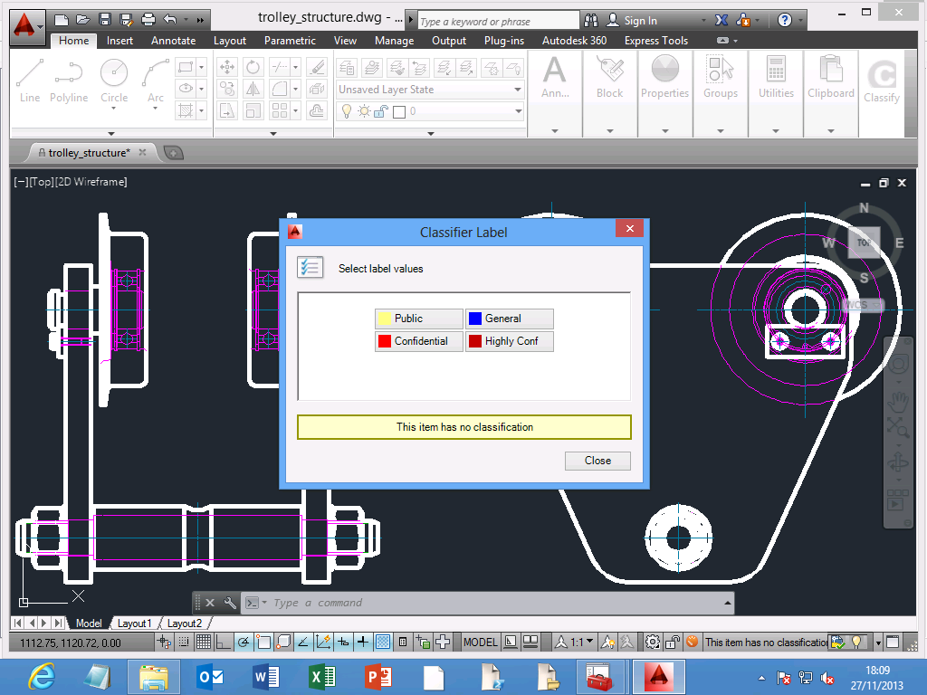
Extending to CAD files…
User Defined Classification

Slide 31
Classification Solutions

Slide 32
Take Control with Classifier
Classifier extends the capabilities of Microsoft products and other applications to allow users to apply relevant visual & metadata labels (protective markings) to messages, documents and files in order to enforce information assurance policies, raise user awareness of data value and drive multiple security technologies.
lassifier
Easy to install client software
Seamlessly extends core MS products
Core Features:
Engage the employee
Educate the employee
Insert visual markings
Raise awareness and understanding
Insert metadata
Control email distribution
Adoption of your information classification policy.
Orchestrate your security technologies.

Slide 33
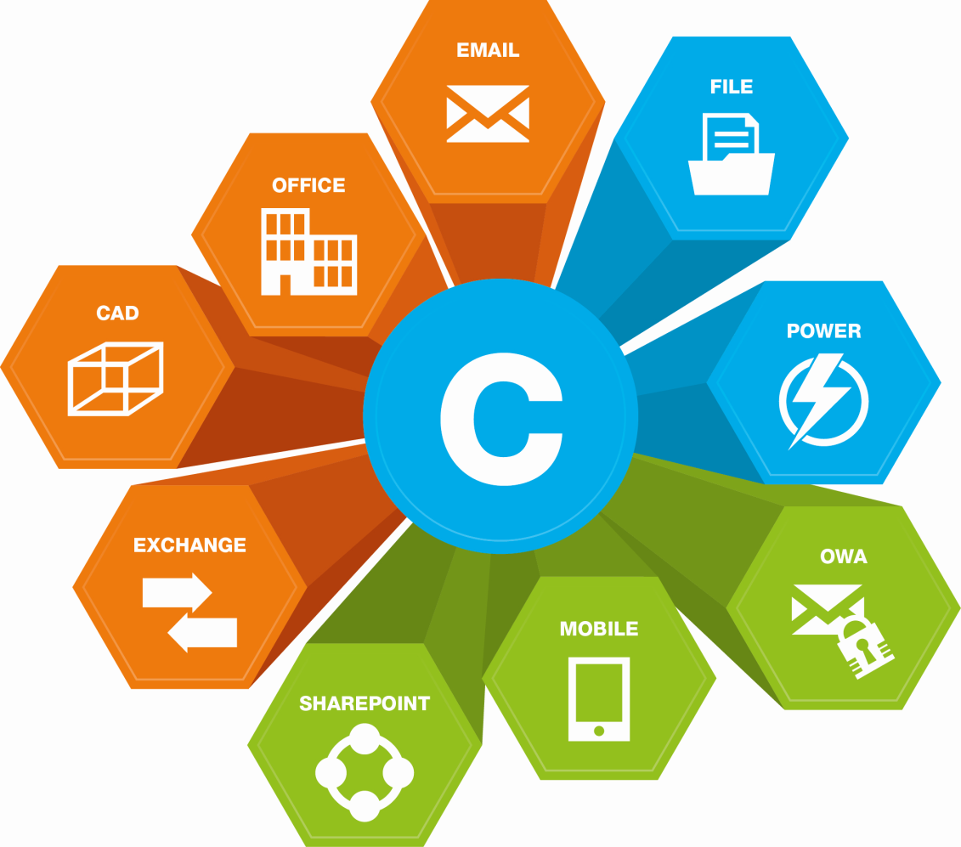
Classifier - securing your data
DATA CREATION AND EXCHANGE
Email Classifier
Email Classification and Release Control for Secure Messaging
Office Classifier
Document Classification – Labelling
and Protective Marking for
Microsoft® Office Documents
EXISTING AND
STORED DATA
File Classifier
File Classification - Security
Labelling for All Types of
Windows Files
Power Classifier
Mass Security Labelling for
Documents and Files
CAD Classifier
Protect Design Documents and CAD Workflow
Exchange Classifier
In-transit Message Classification
- Ensuring Consistency and Improving Collaboration
REMOTE ACCESS AND
COLLABORATION
OWA Classifier
Message Classification
and Release Control for Microsoft Outlook Web App (OWA)
Mobile Classifier
Message Classification and Data Loss Prevention for Mobile Devices
SharePoint Classifier
Security Labelling for Microsoft
Document Management

Slide 34
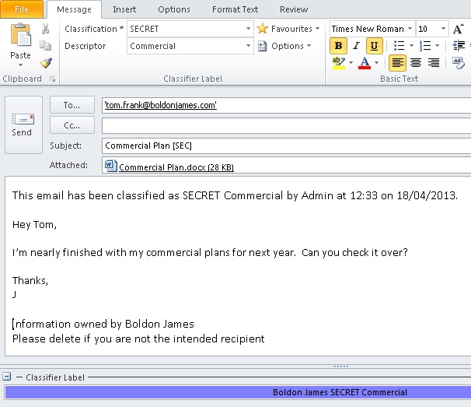
Email Classifier
MICROSOFT OUTLOOK
(OR LOTUS NOTES)
ENFORCE LABELLING / DATA CLASSIFCATION POLICY
DOMAIN, USER, AND ATTACHMENT CHECKS AT THE CLIENT
ENSURE CONSISTENT MARKINGS ARE APPLIED
VISUAL AND METADATA MARKINGS

Slide 35
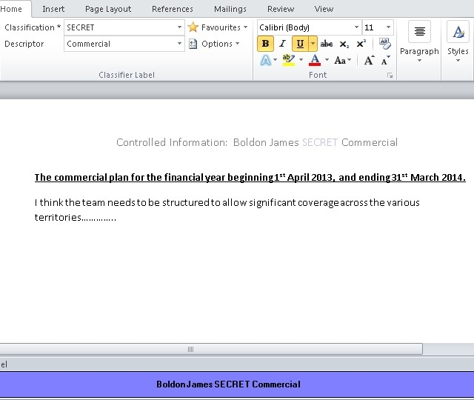
Office Classifier
MICROSOFT WORD,
EXCEL, POWERPOINT,
VISIO & PROJECT
ENFORCE LABELLING / DATA CLASSIFCATION POLICY
ENSURE CONSISTENT MARKINGS ARE APPLIED
VISUAL AND METADATA MARKINGS

Slide 36
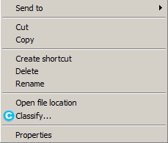
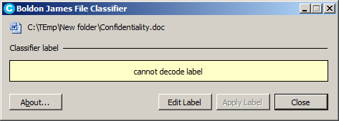
File Classifier
MICROSOFT WINDOWS
SHELL EXTENSION
ENFORCE LABELLING / DATA CLASSIFCATION POLICY
SUPPORT FOR NON-NATIVE FILE TYPES
ENSURE CONSISTENT MARKINGS ARE APPLIED
APPLY METADATA MARKINGS

Slide 37
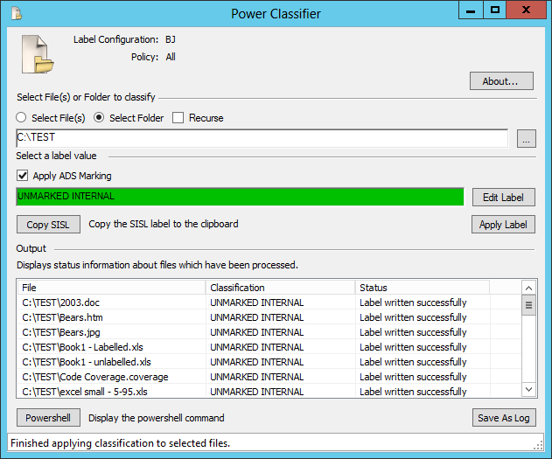
Power Classifier
BULK LABELLING OF
LEGACY FILES &
DOCUMENTS
RETROSPECTIVE APPLICATION OF CLASSIFICATION LABELS
SUPPORT FOR NON-NATIVE FILE TYPES
APPLIES LABELS TO ANY FILE CONTAINED IN WINDOWS FILE STORE
BESPOKE SCRIPT CREATION VIA POWER SHELL

Slide 38
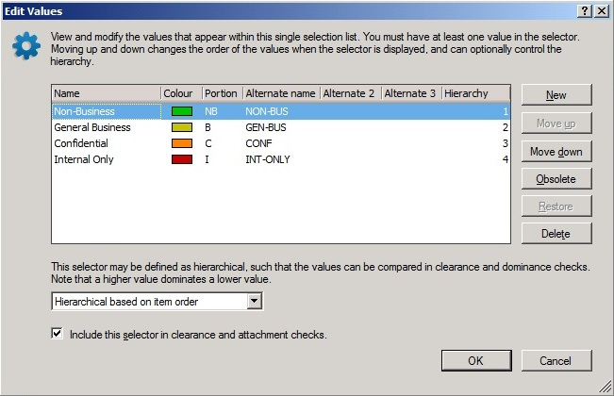
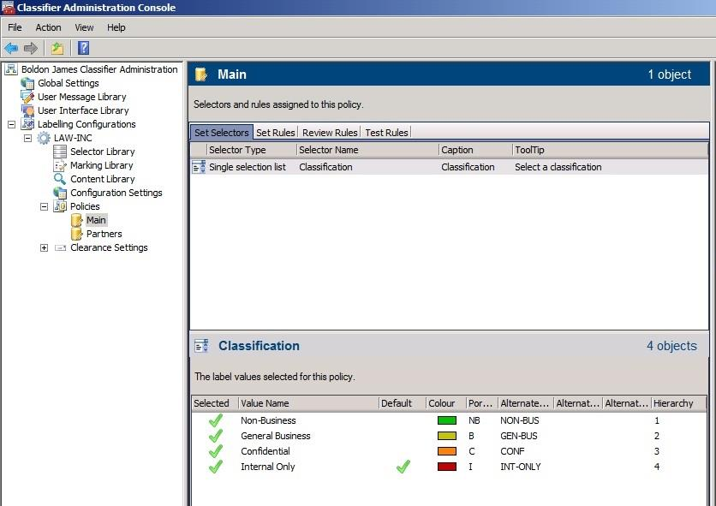
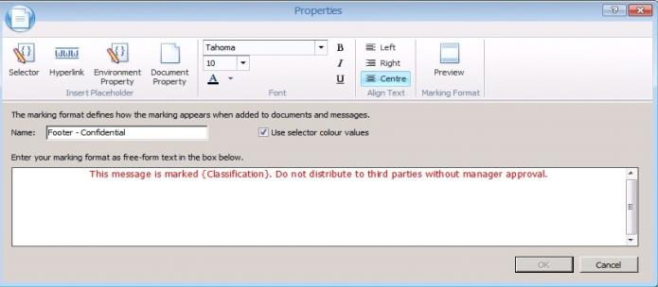
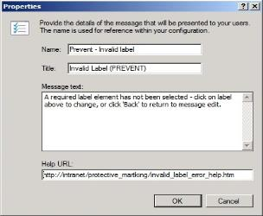
Classifier Administration
UNIFIED ADMINSTRATION
ALL PRODUCTS MANAGED FROM A SINGLE LOCATION
QUICK START TEMPLATES
MULTIPLE POLICY SUPPORT
REUSABLE POLICY COMPONENTS
HIGHLY CONFIGURABLE BEHAVIOURS

Slide 39
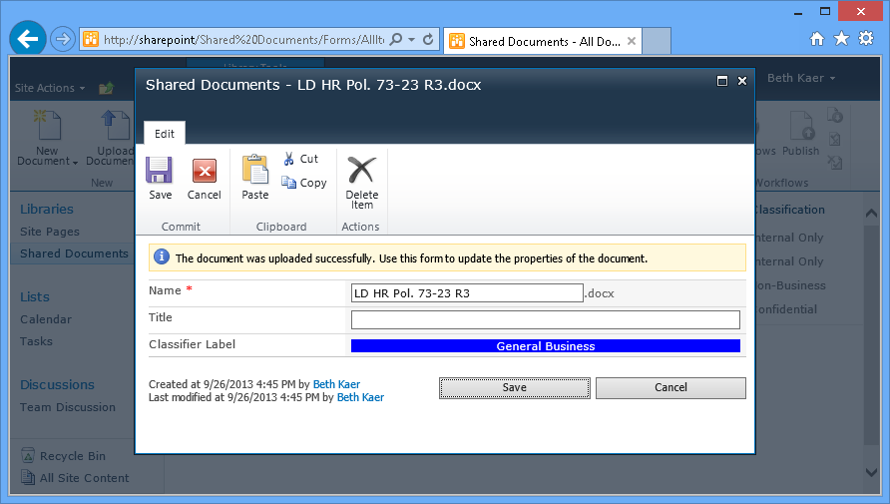
SharePoint Classifier
Check & apply labels upon upload
Enforce classification upon import
Notes:
SharePoint-UploadMarkedDocument
Shows the user (Beth) uploading a new HR policy document (LD HR Pol. 73-23 R3.docx). This document was labelled with Boldon James Office Classifier. SPC automatically recognises EC, OC and FC labels.

Slide 40
Classification Reporting
Dashboards and Reports
Extensible by customer
The dashboards and reports reflect
Principals – who is doing what
Content – what content is being processed
Actions – which Classifier rules are honoured / ignored
Notes:
6 dashboards and 6 reports
Extensible by customer – can add own dashboards/reports
Concentrates on who is doing what to what

Slide 41
Sample Dashboards / Reports
Monthly trends against policy violations
Attachment names for each classification value
Types of documents for each classification value
Individual users making policy violations
Email domains receiving sensitive information
…Create your own dashboards and reports

Slide 42
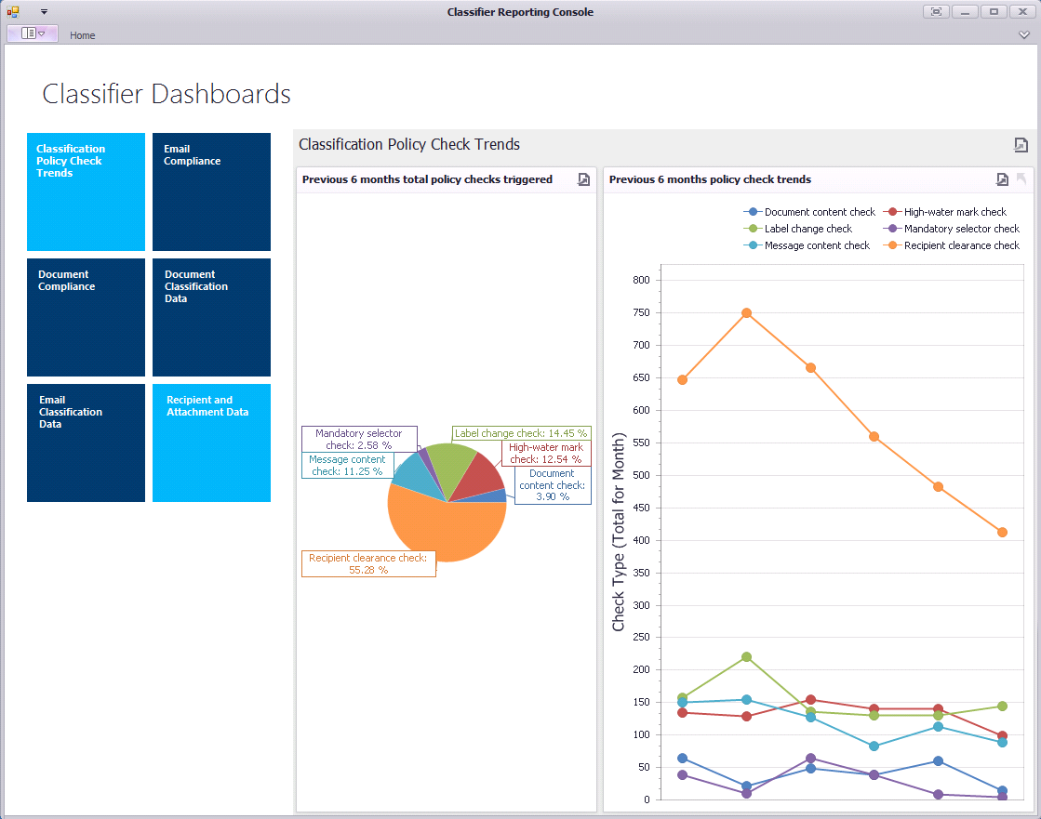
Dashboard example
Notes:
Dashboards selectable on left; presentation on right
Can be bar charts/pie charts etc
Will be able to select check per-application

Slide 43
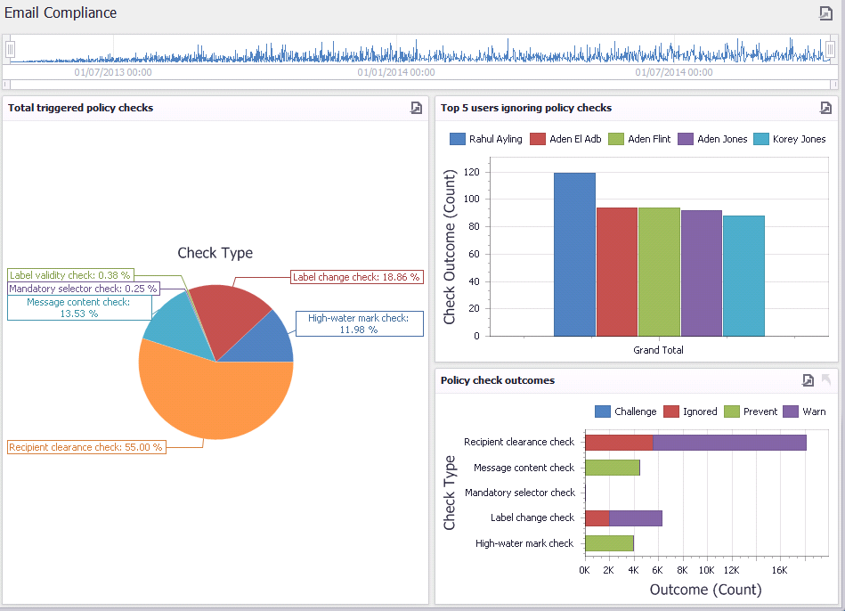
Email Classification Dashboard
Notes:
Triggered checks for email
Time period can be changed
Users ignoring warnings – can drill down to each document/email where policy check has been triggered
Total type of check outcomes for each check

Slide 44
Benefiting from Data Classification
Notes:
Review some of the ways your business can benefit from data classification…

Slide 45
How data classification can help
Raise User Awareness
Control Unstructured Data
Protect valuable and sensitive information
Drive technology via metadata
Simplify access control
Notes:
Already touched on most of these
- Case study to highlight the role of classification in raising user awareness…

Slide 46
How data classification can help
Raise User Awareness
Control Unstructured Data
Protect valuable and sensitive information
Drive technology via metadata
Simplify access control

Slide 47
Raising User Awareness
Focus on putting the user at the heart of their data security strategy
60% improvement in user security awareness
Tool transformed users’ security culture
Heightened awareness spilled over to printed documents
Requests for more lockable office storage
89%
reduction in data loss incidents
Users asked for data classification tool back when removed
Internal security awareness measure increased from 29% to 89%
Notes:
It’s not all about ever more sophisticated security technology
It’s about getting the people-dimension right
Focus on putting the user at the heart of their data security strategy
Huge psychological impact on the users – transformed their security culture
Heightened awareness spilled over to printed documents
Staff asked for more lockable office storage to lock away all the ‘new’ sensitive data
When data classification removed, users asked for it back
Internal security awareness measure increased from 29% to 89% after data classification implemented

Slide 48
How data classification can help
Raise User Awareness
Control Unstructured Data
Protect valuable and sensitive information
Drive technology via metadata
Simplify access control
Notes:
Already touched on most of these
- Case study to highlight the role of classification in raising user awareness…

Slide 49
Driving other technologies
eDiscovery (Search & Retrieval)
Data
Governance
Event
Monitoring
(SIEM)
Mobile Devices
Platform
Metadata
Classification Metadata can drive complementary security and information management technologies:
Data Loss
Prevention
(DLP)
Access
Control
Encryption
Guards & Gateways
Document
& Records Management
(EDRMS)
Info
Rights Management
Archiving

Slide 50
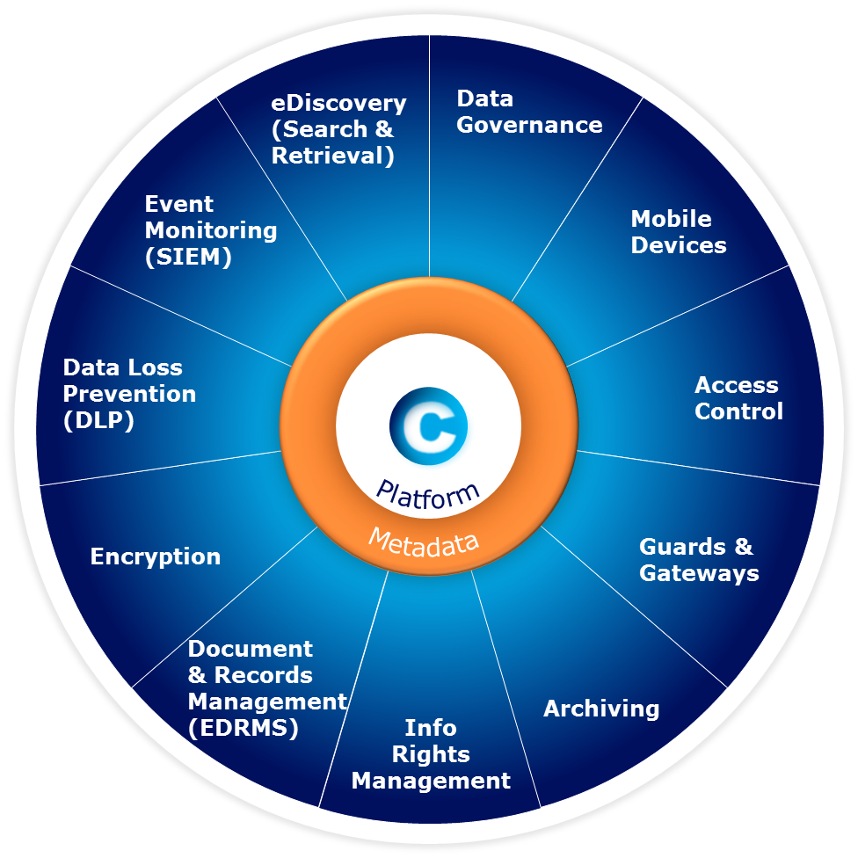
Technology partnerships
eDiscovery (Search & Retrieval)
Data
Governance
Event
Monitoring
(SIEM)
Mobile Devices
Platform
Metadata
Data Loss
Prevention
(DLP)
Access
Control
Encryption
Guards & Gateways
Document
& Records Management
(EDRMS)
Info
Rights Management
Archiving
Notes:
Just a selection of the technology partners that we currently are working with

Slide 51
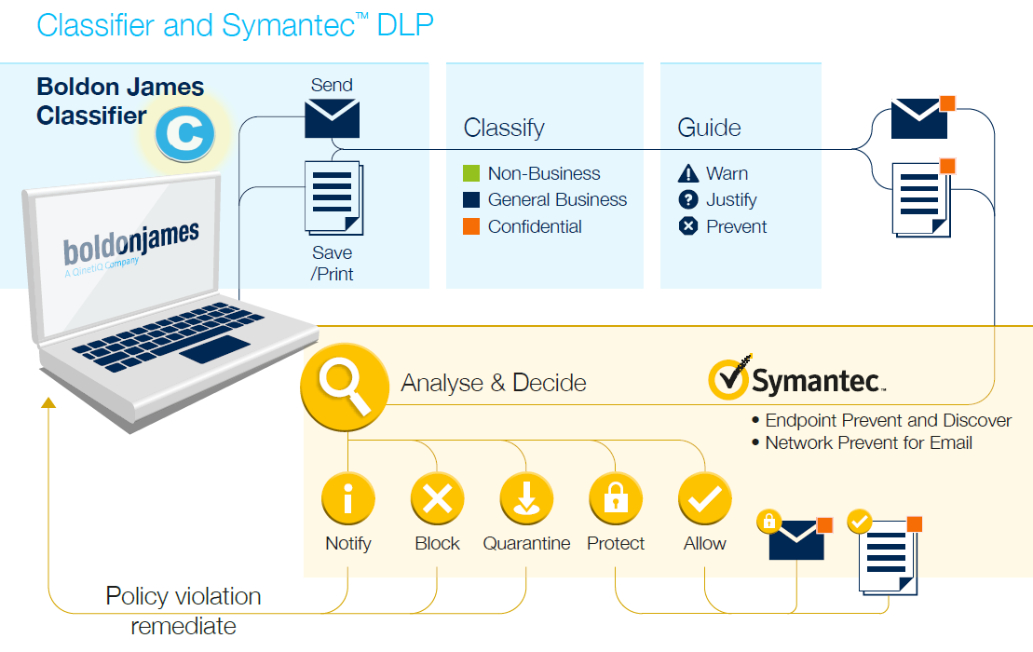
Driving Symantec DLP
Notes:
Flat/static slide showing how we work with Symantec

Slide 52
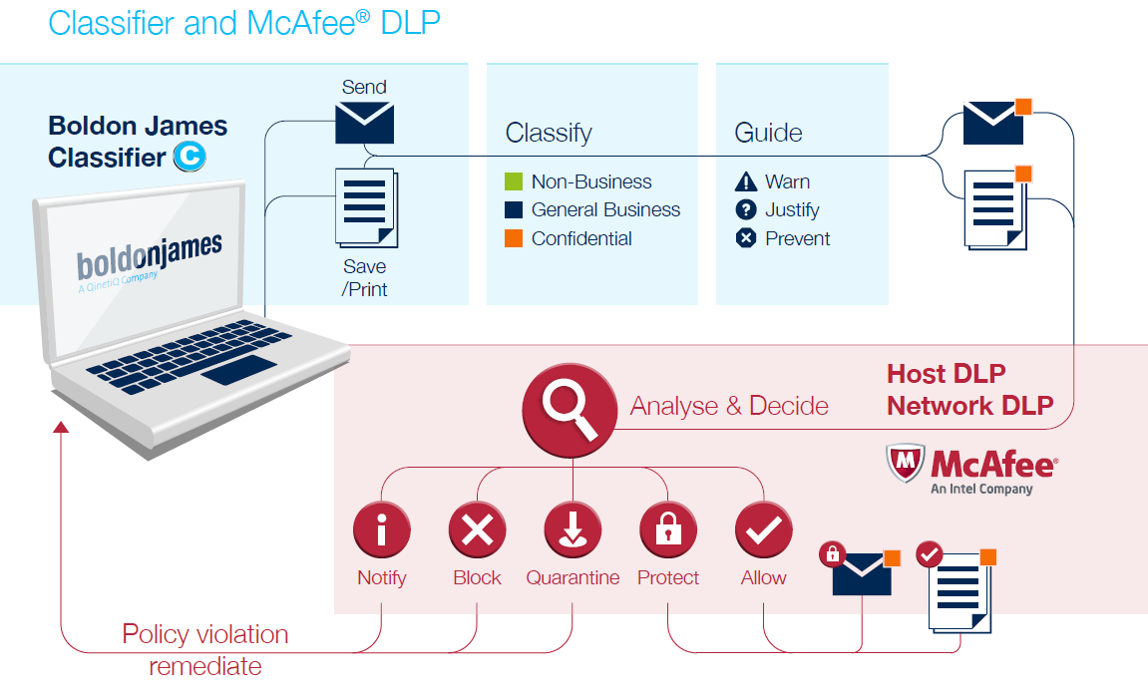
Driving DLP solutions
Notes:
Animated slide

Slide 53
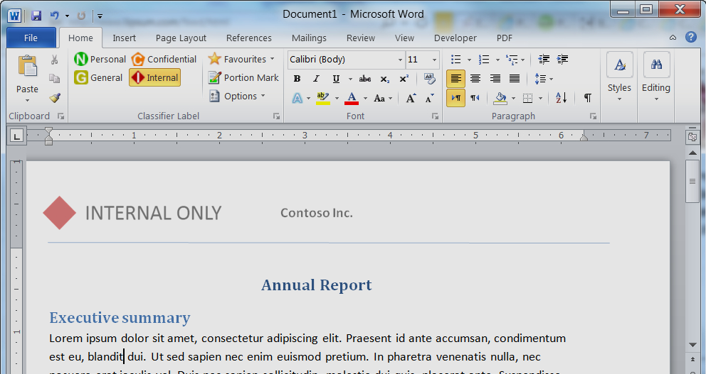
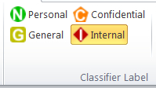
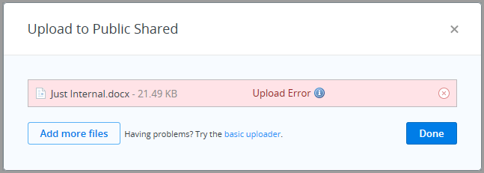
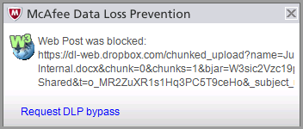
Enhancing DLP solutions
Helping to improve DLP accuracy via metadata labels….
…and prevent offload to external devices and upload to the Cloud, for example…
Notes:
Used in combination with a DLP solution, Data Classification (Classifier) can be used very effectively to protect the upload of files to Cloud storage sites such as DropBox for example….

Slide 54
Greater ROI from DLP
Applying User-driven Data Classification
1000
800
600
Investigation
Incidents per week
Education
400
Notification
200
Prevention
0
Risk reduction over time
Notes:
Introducing DLP can a major undertaking
Our partners identify these Four Stages to a typical DLP project – focus on reduction in security incidents over time
- Investigation is the Discovery stage – baseline the security incidents
- Education is the soft stage - education and training of users
- Notification is where technology starts to provide Warnings to users
- Prevention is where Blocking controls are applied
[CLICK] Each stage can benefit from data classification – reducing scale of the task and improving the results.
With underperforming DLP rules – FPs could be reduced by as much as 90%
Reduction up to 90% of ‘false positive’ errors

Slide 55
How data classification can help
Raise User Awareness
Control Unstructured Data
Protect valuable and sensitive information
Drive technology via metadata
Simplify access control
Notes:
Already touched on most of these
- Case study to highlight the role of classification in raising user awareness…

Slide 56
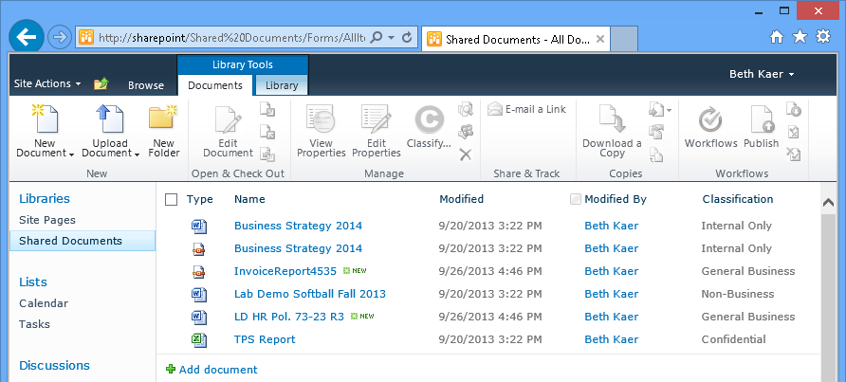
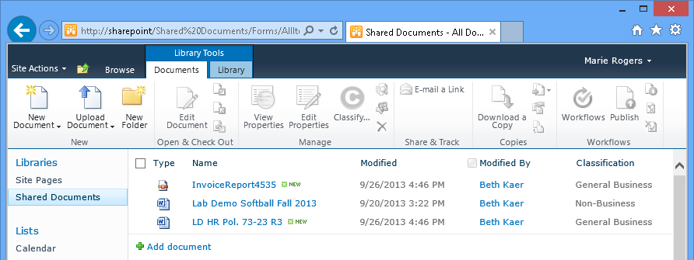
Simplify access control to shared data
Employee View
Partner View
Notes:
- Applying classification to the control of access to shared data.
- Introducing the idea of classification-based permissions for users - Clearances
SharePoint-BethView
Shows the newly uploaded documents, along with some other documents with different labels. NB: Beth has access to Non Business, General Business, Confidential, and Internal Only marked documents
SharePoint-MarieView
Switching to a new user, (NB: username in top right hand corner of the screen) we see that Marie has access to only Non Business and General Business documents. This is based on Active Directory attributes, or clearances. These same clearances are used by EC to restrict message delivery based on labels.

Slide 57
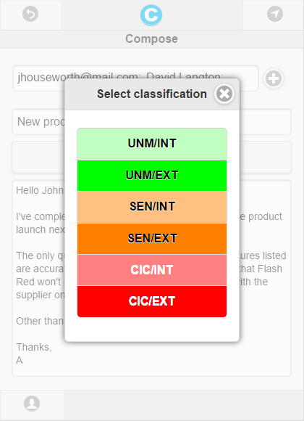
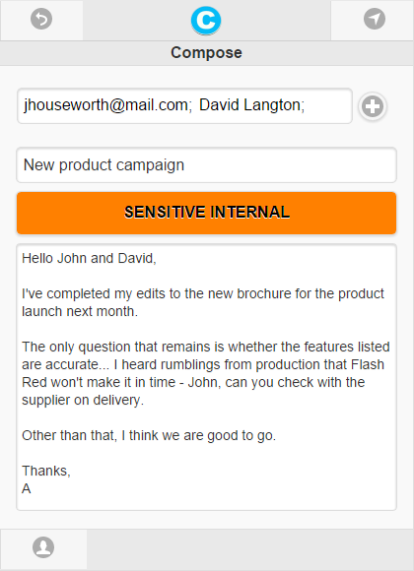
Protecting data on the move
Mobile Classifier Email labelling for mobile data
Web-based email app
Lightweight mobile app leveraging Microsoft OWA/EWS
Multiplatform – Android and iOS, Windows mobile
Multi-format – Smartphone and tablet touchscreen
Compatible with Exchange Online (Office 365)
Notes:
Reference to Mobile Classifier (‘coming soon’ – Q3 2014)

Slide 58
Improving Business Performance
Companies who have a Best-in-Class security score are 3 times more likely to be using data classification.
Companies who have a Best-in-Class security score are 3 times more likely to be using data classification.
Data Classification as a Current Enterprise Capability by Maturity Class 2007-2012
%
Percentage of Respondents
Source: Aberdeen Group, February 2013
Notes:
5% annual increase in companies adopting Data Classification

Slide 59
Case Studies: Implementing Data Classification
Notes:
Putting a toe into the water of best practice…

Slide 60
Case study: protecting valuable data
Background
Management concerned about accidental release of commercially-sensitive content
Decision already taken to enhance collaboration and information sharing
Focus on brand and employee protection
The Challenge
Stretched archiving procedures & reduced storage costs
Wide spectrum of data types and sources to consider - including surveys, financials, energy production projects
Lack of knowledge about what data was being stored in tools like SharePoint and Symantec
Discover what data they had and define a data classification policy
Notes:
“Already, the situation had been identified as a cause for concern, but with board- level strategic initiatives which included enhanced collaboration and information sharing, as well as long-term plans to archive historic data, the issues of managing information and ensuring that its handling and release conformed to strict regulations, processes and procedures, was becoming critical.”
CHALLENGE:
Big Data had stretched their archiving procedures to the limit and they wanted to find a way to reduce the cost of long term storage
Data included emails, files and documents that address a wide variety of commercially-sensitive issues, including surveys, projected productions, financials, legal responsibilities and implications
They already had lots of tools they just didn’t know what data was contained in them
Overall challenge as to discover what data they had then define an appropriate data classification (and management) strategy/policy to fit the needs of their business

Slide 61
Case Study cont.
Requirements & Constraints
Integration with existing applications & platforms – SharePoint, intranets, supplier extranets
Meeting strict industry regulations, processes and procedures
Future attainment of ISO27001
Ensuring the solution had a low overhead and seamlessly integrated with Symantec’s email security suite
The flexibility to apply different rules to different user communities
Notes:
CONSTAINTS:
Had to integrate with and enhance existing applications including collaboration tools such as SharePoint, and intra/extranets which they used to share information with partner organisations
ISO27001 – management, storage, control/release of data
Low overhead, easy to deploy and seamless integration with DLP/EV solutions
The flexibility to apply different rules to different user communities . “One size will not fit all”

Slide 62
Typical large organisation solution timeline
Involve Super-Users in PoC to test applicability of classification policy & level of integration with complementary solutions
Requirements & Data Classification Policy
Deep data dive/audit
Solution evaluation, Down select, Initial Product Trial (PoC)
Full roll-out in advisory mode, complete user training & awareness
Decision made that solution needed
1 month
2-3 months
4-6 months
6-9 months
9-12 months
Senior Management Team Involvement & Sponsorship
Notes:
Engaged with senior stakeholders to get buy-in
In-depth testing and live demonstrations enabled senior management to visualise the ease of use of classification solutions
Introduced the changes in a low impact way
Day one advisory
Slowly enhanced the controls to be mandatory
Monitored label changes to target training and awareness
Drive Rights Management and Encryption technologies by using valuable metadata as the key

Slide 63
Customer Results
Benefits
SharePoint Classifier enabled users to apply labels to files held in SharePoint
Increased user awareness of the value of sensitive information
Metadata ensured consistent control over the dissemination of information
Radical improvement in the way SharePoint-sourced information is managed, controlled and shared throughout the organisation.
Classifier helped enforce corporate policy and rules on handling and release of emails
Boosted ROI in DLP, encryption, archiving & storage, e-discovery, information rights management and ERDMS
Helped meet key regulatory and assurance requirements, including ISO27001
Core part of the organisation’s data protection strategy
Notes:
SharePoint Classifier enabled users the ability to apply labels to relevant files held in SharePoint
Metadata ensured consistent control over the dissemination of that information.
Increased user awareness of the value of sensitive information
Radical improvement in the way emails, documents and SharePoint-sourced information is managed, controlled and shared throughout the organisation.
Classifier helped enforce corporate policy and rules on handling and release of emails
Boosted ROI in DLP, encryption, archiving & storage, e-discovery, information rights management and ERDMS
Helped meet key regulatory and assurance requirements, including ISO27001

Slide 64
Data Classification Best Practice
Notes:
Putting a toe into the water of best practice…

Slide 65
What a Policy Looks Like
Internal
Confidential
Public
Notes:
Public – Information that may or must be open to the general public. It is defined as information with no existing local, national, or international legal restrictions on access or usage. Examples include: Publicly posted press release, Publicly available marketing materials, Publicly posted job announcements
Internal – Information that must be guarded due to proprietary, ethical, or privacy considerations and must be protected from unauthorised access, modification, transmission, storage or other use. Examples include: General employment data (e.g. salary) Business partner information
Contracts
Confidential – Highly sensitive data intended for limited, specific use by a workgroup, department, or group of individuals with a legitimate need-to-know. Examples include:Payment Card Industry (PCI) Sarbanes–Oxley Act (SOX) Privacy
First step: What to include in a classification scheme?
- Most will have a Hierarchy that follows business impact level/severity of exposure
- Normally augmented by NON-BUSINESS/PERSONAL and GENERAL BUSINESS.
- If ‘No Label’ allowed – what will it mean?
- Don’t overlook the value in adding other qualifiers/caveats alongside the hierarchy

Slide 66
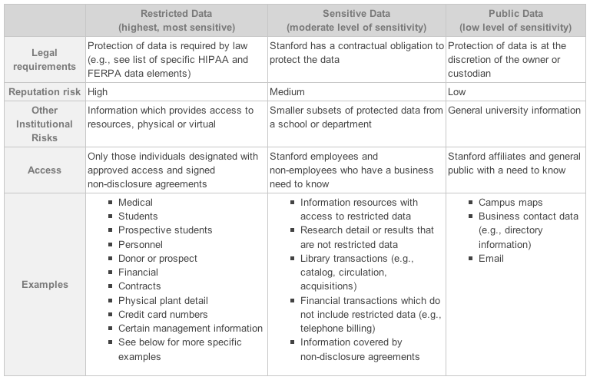
Data classification policy (cont.)
Notes:
Example of a data classification from Stanford university…
Hierarchy largely based on reputation risk and legal requirements

Slide 67
User Driven Data Classification - Best Practice
Keep Policy Simple & Easy to Use
One size does not fit all
Consider how you Collaborate
Plan For Legacy Data
Close the loop
Notes:
Keep Your Policy Simple
The simpler your policy is, the more likely it is that it will be adopted and used correctly. Keep language and terms used for classification labels simple. Don’t be afraid of adding business, department or process-specific elements into your labelling scheme, as long as the basic elements are simple and common to all.
Made It Quick and Easy To Use
Data Classification is often a new process for employees, so the task of applying a classification needs to be made as simple as possible. Classification must be a seamless part of the productivity tools that users use on a day-to-day basis - make sure you consider all the applications which your users will employ when creating and managing data. A common user experience across key productivity applications ensures that users can move between them without having to re-learn classification techniques.
One Size Doesn’t Fit All
Your classification scheme and solution will need to be able to handle diversity within your organisation. Large multinationals must take account of local or regional data-handling requirements and legislation, as well as language considerations. Bring Your Own Device (BYOD) inevitably adds to the range of devices and applications that will be used to create and manage data in your organisation.
Allow For Partnering /Collaboration
Any form of partnership requires organisations to share data in a controlled manner, so a classification solution should be adept at interpreting and interoperating with the classification schemes of other organisations. This way, your users won’t be faced with the challenge of having to understand the handling and safeguarding requirements of each partner’s data.
Make A Plan For Your Legacy Data
Forrester² recommends that you classify new data first, and address legacy data later as a separate project, once you’ve established a process for classifying new data. There are a number of approaches that you could take to classifying your legacy data:
Get users to classify legacy data immoderately
Classify legacy data only as it’s modified
Bulk classify
Close The Loop
Allow for a regular review and analysis of the information being classified (or not classified in some cases) so that you can then communicate the results to the business owners responsible for safeguarding confidential information and, where appropriate, to the individual users concerned.

Slide 68
Summary
Why put Data Classification at the centre of your layered security approach?
Empowers users & increases data security awareness
Supports more effective archiving procedures, reducing storage requirements and costs
Adds context and meaning to unstructured data
Supports compliance to industry regulations and standards
Applies valuable metadata to drive greater efficiencies across other enterprise security and information management technologies
Supports more secure collaborative & remote working
Maintains business viability – protects intellectual property
Fast becoming security best practice – the smart thing to do
Notes:
Footnote…
We’re not the only ones saying this is the smart thing to do…
FORRESTER REPORT:
Data classification top priority for 2014
41% high priority
15% business critical

Slide 69
Thank you.
<name>
<email>
Connect with us…
Twitter: @boldonjames
Web: www.boldonjames.com

